Slide 1
“Liquidity and the Impact of Information Shocks:
A Macroeconomics Course Application”
Chapter 3 in
Liquidity, Markets and Trading in Action
Deniz Ozenbas, Michael Pagano, Robert Schwartz, and Bruce Weber, Springer, 2021, forthcoming

Slide 2
The Important Role of Macroeconomic Information Shocks
A macroeconomics course has many elements that cover key decisions by consumers, producers, investors, and governments related to consumption, investment, saving, interest rates, taxes, etc.
We consider here how information shocks in the macroeconomy can affect financial markets, and vice versa, by changing investor’s expectations
Slide 2

Slide 3
How the Macroeconomy affects Stock Prices
The “Intrinsic” or “Fundamental” Market Value of a firm’s stock can be calculated as the sum of the firm’s future free cash flows to shareholders (FCF_{equity}) discounted at the shareholders’ required return (R_{equity}).
This value (V₀) can be estimated as follows:
∞
∑
FCF_{equity,t}
V₀ =
(1 + R_{equity})^{t}
t = 1
Slide 3

Slide 4
How the Macroeconomy affects Stock Prices (cont.)
The key stock valuation variables (FCF_{equity} and R_{equity}) are affected by news about many Macroeconomic factors such as:
Real GDP Growth & Inflation
Employment & Wage Growth
Personal Consumption and Saving
Capital Investment
Taxes & Government Spending
Interest Rates & Exchange Rates
These macro factors are driven via choices by: Consumers, Businesses, Investors, and Government
Slide 4

Slide 5
What Motivates Trading?
New information (unexpected news)
Divergent Expectations (people agree to disagree due to new information)
Liquidity needs (“uninformed” traders)
Technical (“noise”) trading
So… Unexpected News about the economy can lead to a large amount of trading which can then affect everyone’s economic decisions, which then again affects trading, etc., … in an interactive feedback loop
Slide 5

Slide 6
An Example of how Macro Shocks affect Stock Prices
News of unexpectedly strong data on Consumer Spending and the Purchasing Managers Index from last month leads to an increase in investor optimism
More optimistic investors then revise upwards their expectations of future corporate cash flows and are willing to take more risk
Better expectations about future cash flows cause “fundamental” values to rise above current market prices for stocks
Investors then place orders to buy stocks and push up market prices towards their new, higher “fundamental” values but have to deal with “market frictions” like divergent expectations, price impact, volatility
Equilibrium occurs in the stock market and buy orders stop being submitted once market prices are equal to fundamental values
Slide 6

Slide 7
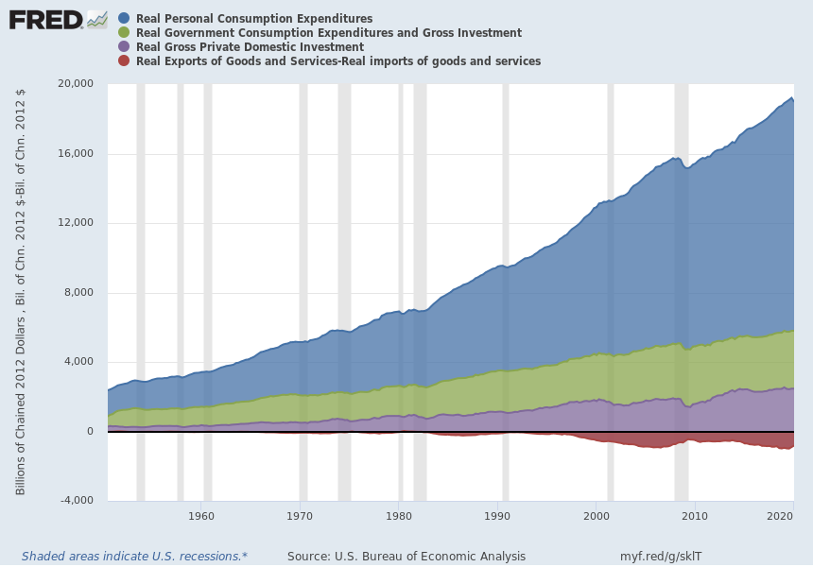
Main Components of Total Output (Real GDP)
Total Output = Y = C + I + G + NX
Slide 7

Slide 8
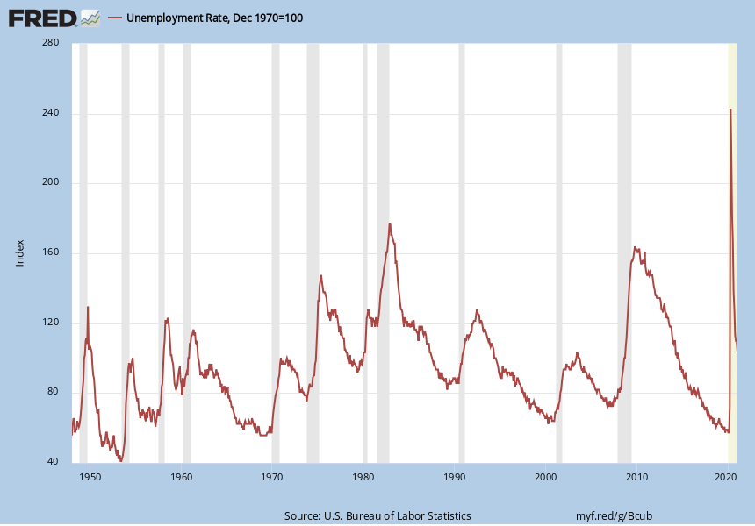
U.S. Unemployment Rate is volatile (but lagging)
Slide 8

Slide 9
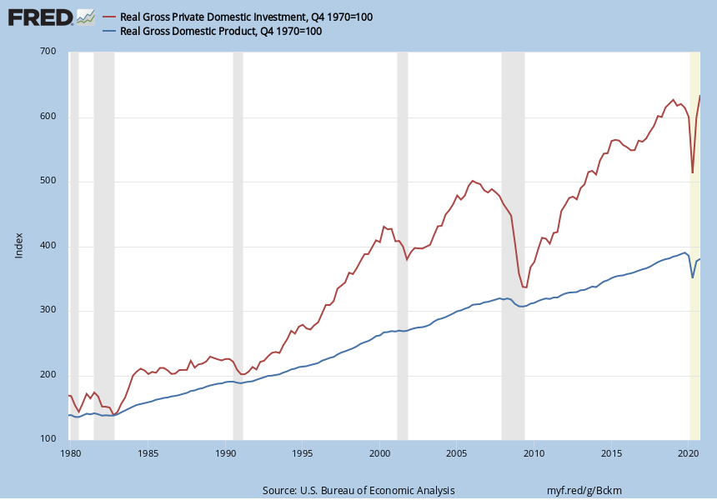
U.S. Investment is volatile and leads Real Output
Slide 9

Slide 10
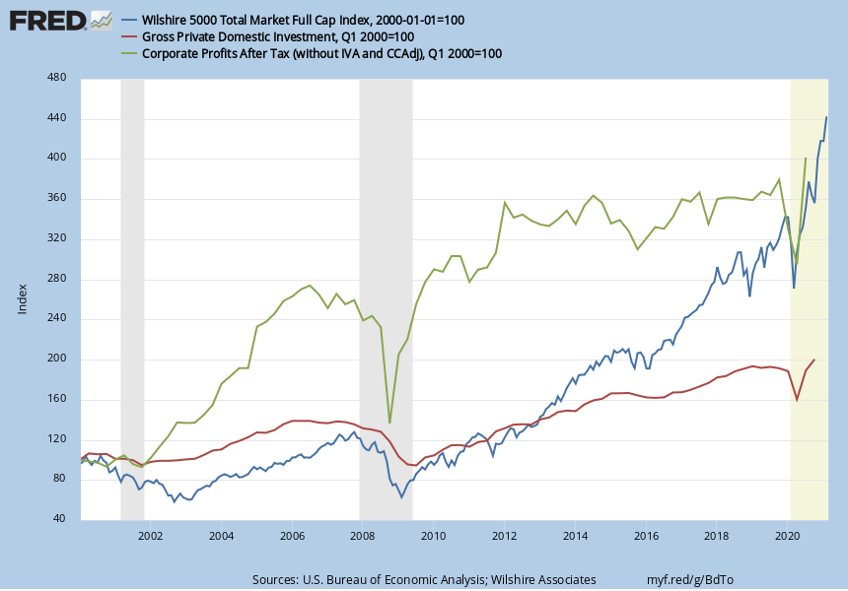
U.S. Investment, Corporate Profits, &
Stock Prices are Positively Correlated
Slide 10

Slide 11
The Business Cycle, Interest Rates, and Interactive Feedback Loops
Individual decisions by Consumers, Businesses, Investors, and Government lead to fluctuations in GDP and the demand for money to create “Business Cycles”
Interest Rates and Prices respond to these fluctuations and move upward during an economic “Boom” and downward during a “Bust”
Changes in Interest Rates are a key Signal of Macro conditions that all “players” must follow.
Slide 11

Slide 12
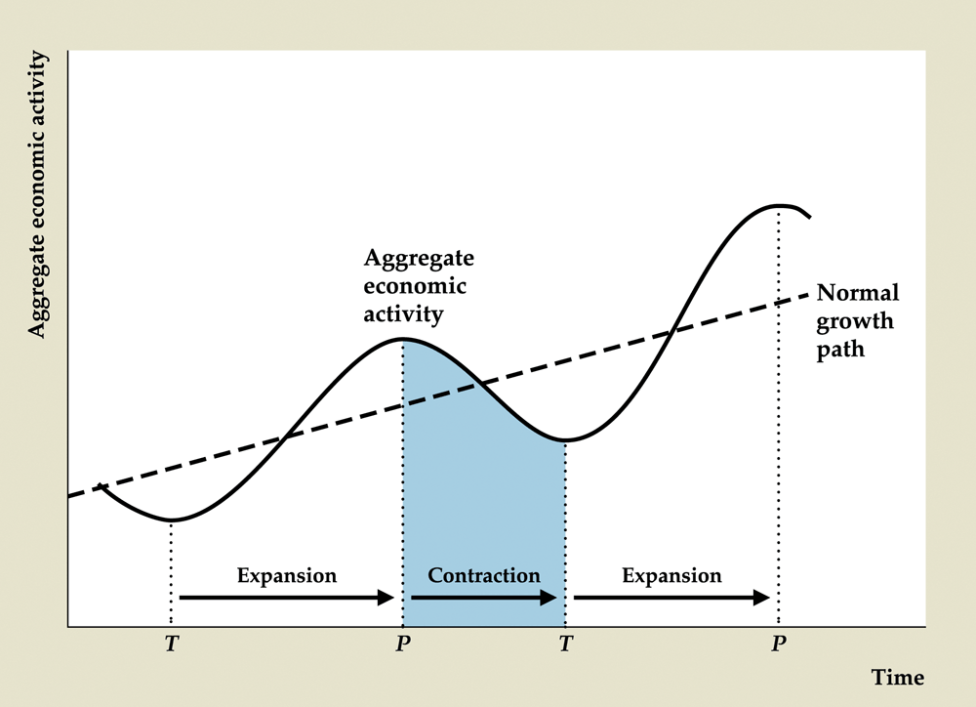
Stylized View of the Business Cycle
Slide 12

Slide 13
Vicious vs. Virtuous Business Cycles
Virtuous Cycle: when positive economic factors reinforce each other, e.g.,
Strong Employment => More Consumer Spending => Larger Bus. Profits => Increased Bus. Investment => Further Employment Gains…
Vicious Cycle: when negative economic factors reinforce each other, e.g.,
Weak Employment => Less Consumer Spending => Smaller Bus. Profits => Decreased Bus. Investment => Further Employment Losses…

Slide 14
Possible Reactions to Interest Rate Signals
When long-term interest rates rise because of a “virtuous” cycle:
Investors shift more money into the stock market and out of the bond market
Businesses and Consumers are both confident and spend more
Fed might want to avoid “over-heating” by and raising Fed Funds rate and selling Treasurys via “OMO” in financial markets
Slide 14

Slide 15
Reactions to Interest Rate Signals (cont.)
When long-term interest rates fall because of a “vicious” cycle:
Investors shift money out of the stock market and into the bond market
Businesses and Consumers are both nervous and spend less
Fed might want to reverse any “cooling-off” by lowering Fed Funds rate and buying Treasurys via “OMO” in financial markets
Slide 15

Slide 16
Business Cycles & Government Actions
Monetary Policy is controlled by the Federal Reserve which has two competing goals:
Stimulate healthy economic growth, and
Control inflation at a manageable level.
Primary tools are the Fed Funds rate and Open Market Operations
Fiscal Policy is controlled by the Federal Government which has three key tools:
Discretionary government spending (e.g., Covid-related CARES Act, infrastructure, military),
Ability to enact new taxes (to increase Govt. Revenue), and
Automatic Stabilizers (e.g., income taxes, unemployment benefits).
Slide 16

Slide 17
The Interest Rate Cycle & Yield Curve
Yield Curve can be a Leading indicator of both the Stock Market and Economy.
Federal Reserve sets short-term rates but…
Long-term rates are set by investor expectations of economic growth and inflation.
Bonds and Money Market instruments can be competitors to Stocks, so investors shift between them depending on the direction of interest rates.

Slide 18
Interest Rate Cycle & Yield Curve (cont.)
The Slope of the Yield Curve (YC) can help Investors, Businesses, Consumers, and the Government plan for the future:
“Normal” Upward Slope: Middle Bull Market
Steep: New Bull Market
Inverted: Bearish Stock Market
Flat YC (no slope): Mixed (Neither Bull nor Bear)

Slide 19
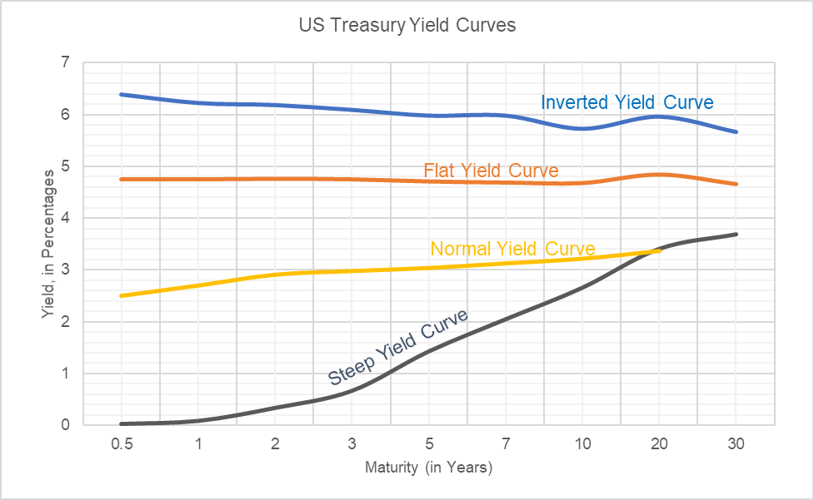
Interest Rate Cycle & Yield Curve (cont.)

Slide 20
An Example of How to Use Interest Rate Signals: Sector Rotation in the Stock Market
Stock Market is a leading economic indicator based on the slope of Yield Curve (which leads economy and stocks).
Different Industry Sectors shine at various points during the business cycle and different stages of the market, e.g.,
Stage of Market | Bull Market | Bear Market
Early | Transportation (Steep Yield Curve) | Consumer Staples (Inverted Yield Curve)
Middle | Capital Goods (Normal Yield Curve) | Utilities
Late | Commodities | Consumer Cyclicals

Slide 21
The Need for Financial Markets in a Macroeconomy
Investors use financial markets to express their expectations about future economic conditions and stock prices
Financial markets can help investors by providing liquidity that ensures trades occur quickly, at low cost, and at reliable, or “fair,” prices
So… financial markets should be structured to provide liquidity as efficiently as possible

Slide 22
Main Types of Financial Markets
 | Transparency | Immediacy | Trading Costs | Volatility
Order-driven (limit order book)
Quote-driven (dealer)
Call Auction
Dark Pool

Slide 23
Order Driven Market
Public
Seller
10:50 10:55 11:00
The limit order book brings buyer& seller together
Places
a Buy
Limit
Order
Limit
Order
Executes
Public
Buyer

Slide 24
The Limit Order Book
Air Pocket
Bid – Ask Spread
(10.95 - 11.10)
Air Pocket

Slide 25
Dealer Intermediation
Dealer
Sells
Public
Seller
10:50 10:55 11:00
Dealer provision
of immediacy
brings buyer
& seller together
Public
Buyer
Dealer
Buys

Slide 26
A Call Auction
Public
Seller
10:50 10:55 11:00
A meeting point
in time can bring multiple buyers & sellers together
Public
Buyer

Slide 27
Call Matches Cumulated Buy & Sell Orders
CUMULATED
SELL ORDERS
Price
52
O
•
51
O
•
P* =
50
O
50
49
O
•
48
O
•
•
CUMULATED
BUY ORDERS
47
1 2 3 4 5 6 Orders
3

Slide 28
Price & Quantity Discovery
The most important objective of any financial market is to foster accurate price and quantity discovery
Much demand is latent – participants do not readily reveal their desires to buy or to sell
Traders instinctively know the price discovery problem. That is why technical analysis is widely used

Slide 29
Price Discovery is Difficult because…
Investors:
Cannot assess share values with precision
Have divergent expectations
Have adaptive valuations that react to news
Do analysts ever agree?

Slide 30
Divergent Expectations &
Price Determination
V(HI) = $30: The Bulls k percent
V (LO) = $20: The Bears 1-k percent
Answer: It depends on k which will vary depending on news about the economy and ABC’s “fundamental” value.
What price(s) will prevail for ABC’s stock?

Slide 31
Technical Analysis
Dynamic Price Discovery due to:
Large, complex information set
Divergent expectations and Adaptive valuations
“Fundamental” Analysis can identify what stock to buy or sell
“Technical” Analysis can identify when to buy or sell a stock

Slide 32
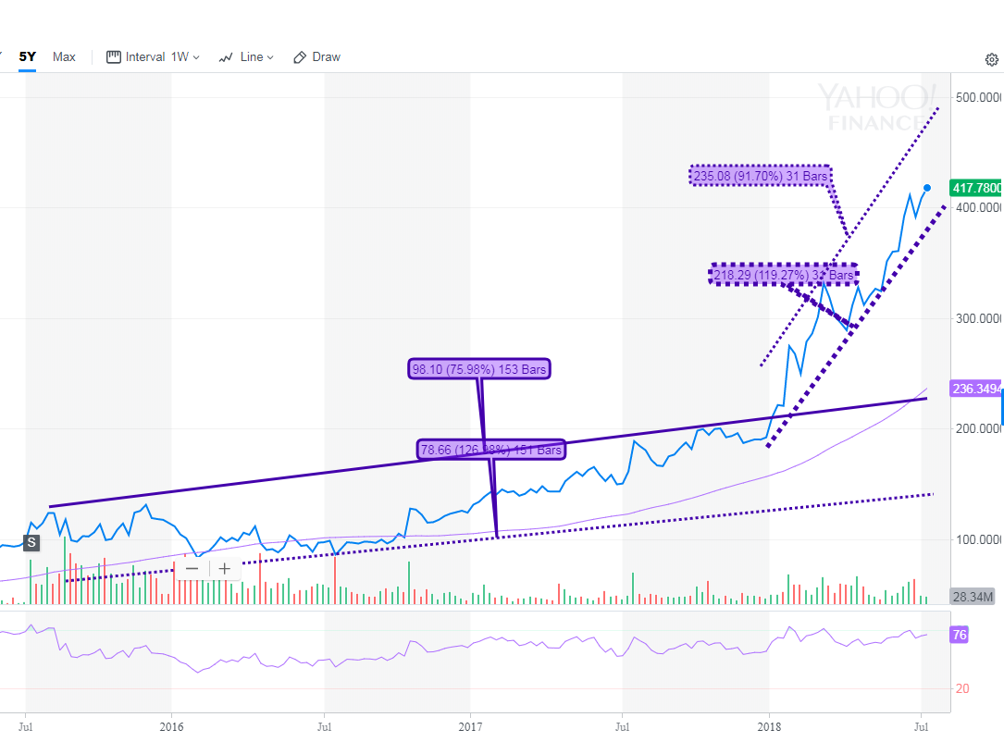
Example of Technical Analysis
This graph includes 2 sets of Trend Lines, a 65-day Moving Average, & a 14-day Relative Strength Indicator (bottom graph) to identify any “gap up” and “gap down” patterns

Slide 33
Some Technical Analysis Techniques
Moving Averages
MACD and Cross-overs
Trendlines and Break-outs
Relative Strength (RSI)
Stochastics / Oscillators
Pattern Recognition (e.g., “head & shoulders”, “pennants”, etc.)
Point and Figure charts
Candlestick charts
Volume and Market Breadth
Money Flow statistics

Slide 34
Wrap-Up
We showed the linkages between Macroeconomic conditions, Interest Rates, and Stock Prices
Demonstrated that unexpected news and the stage of the business cycle can influence stock prices
Explained how important financial markets are for Investors, Businesses, Consumers, and Governments to provide an interactive feedback loop with the economy
We also showed the importance of understanding the types of financial markets (order-driven vs. quote-driven vs. call auctions)
Described how to combine technical and fundamental analysis to decide when to trade
Slide 34

Slide 35
Bonus Slide:
Key Theories of the Business Cycle
Classical / Neo-Classical / Rational Expectations: Adam Smith’s “invisible hand” and the power of market signals
Keynesianism: J.M. Keynes’s “helping hand” of government
Monetarisim: Friedman’s money growth => inflation (ultimately)
Real Business Cycle: productivity shocks are key to growth
Stylized Business Cycle Model:
Δ Business π => Δ Investment => {Δ Interest Rates / Δ Employment / Δ Technology} => Δ Consumption => Δ Business π …

