Slide 1
“Economics and the Equity Market:
A Microeconomics Course Application”
Chapter 1 in
Liquidity, Markets and Trading in Action
Deniz Ozenbas, Michael Pagano, Robert Schwartz, and Bruce Weber, Springer, 2021, forthcoming

Slide 2
The Important Role that Price Plays
A microeconomics course can be titled “Price Theory”
We consider here the role price plays in a standard consumer choice model & in a standard investment model, CAPM
Simular concepts in the two models: “optimal,” “maximum,” “equilibrium”

Slide 3
Indifference Curves
Consumer choice model: a good vs. good tradeoff: good X vs. good Y
Investment model: a good vs. bad tradeoff: risk vs. return

Slide 4
Frictionless vs. Non-Frictionless
Frictionless: useful assumption for some theoretical modeling
Friction: this is the real world. The investment model should deal with risk, return and liquidity
The Gulf Stream & wind, waves, and storms on the surface of the sea

Slide 5
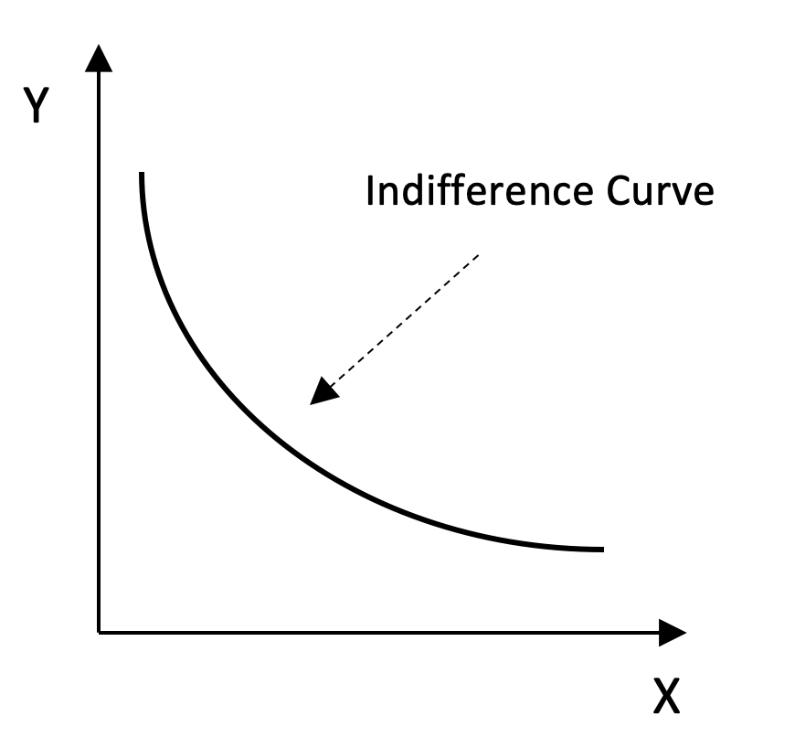
Indifference Curve:
A Good vs. Good Tradeoff
Exhibit 1.1

Slide 6
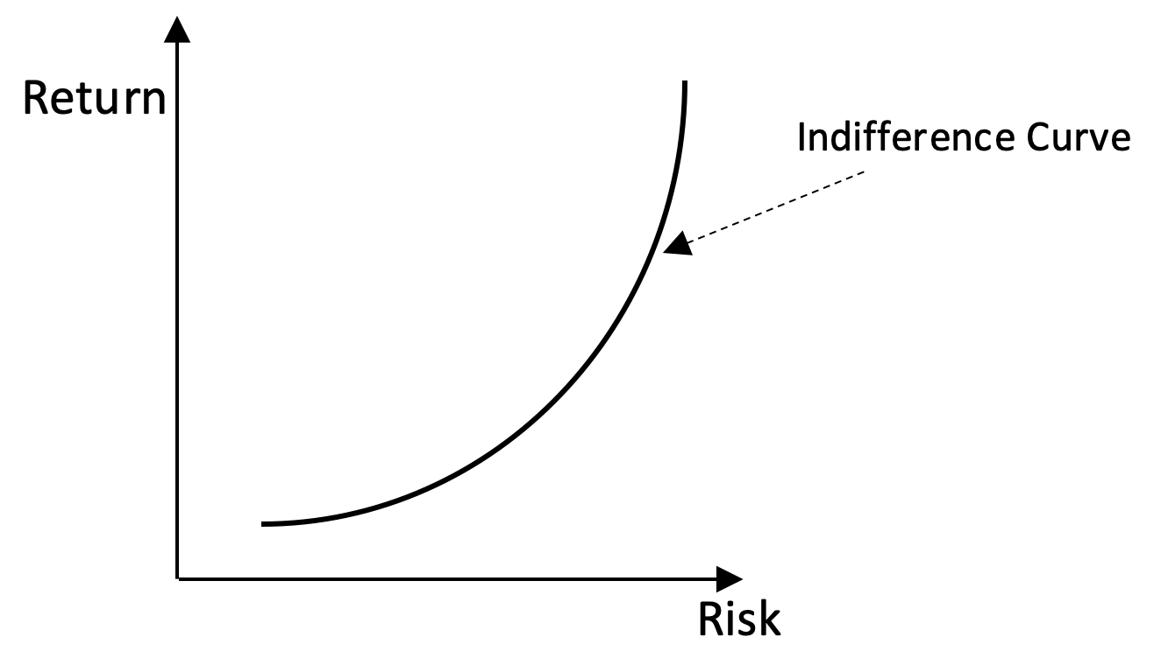
Indifference Curve:
A Good vs. Bad Tradeoff
Exhibit 1.2

Slide 7
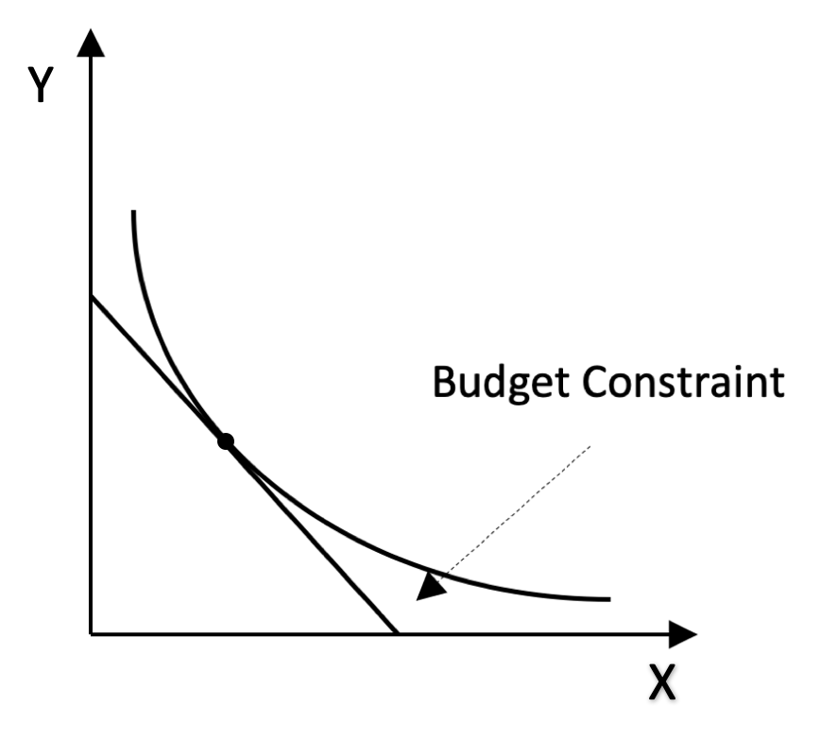
Indifference Curve & Budget Constraint The Consumer Choice Model
Exhibit 1.3

Slide 8
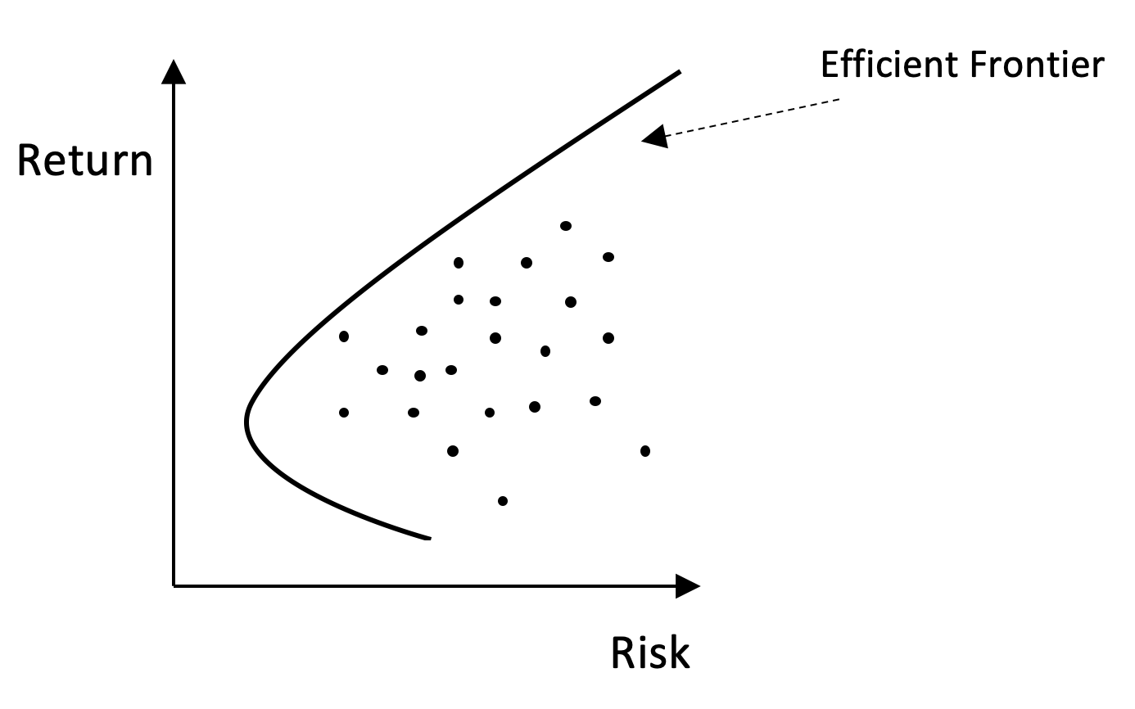
The Efficient Frontier
Exhibit 1.4

Slide 9
The Investment Model
(CAPM)

Slide 10
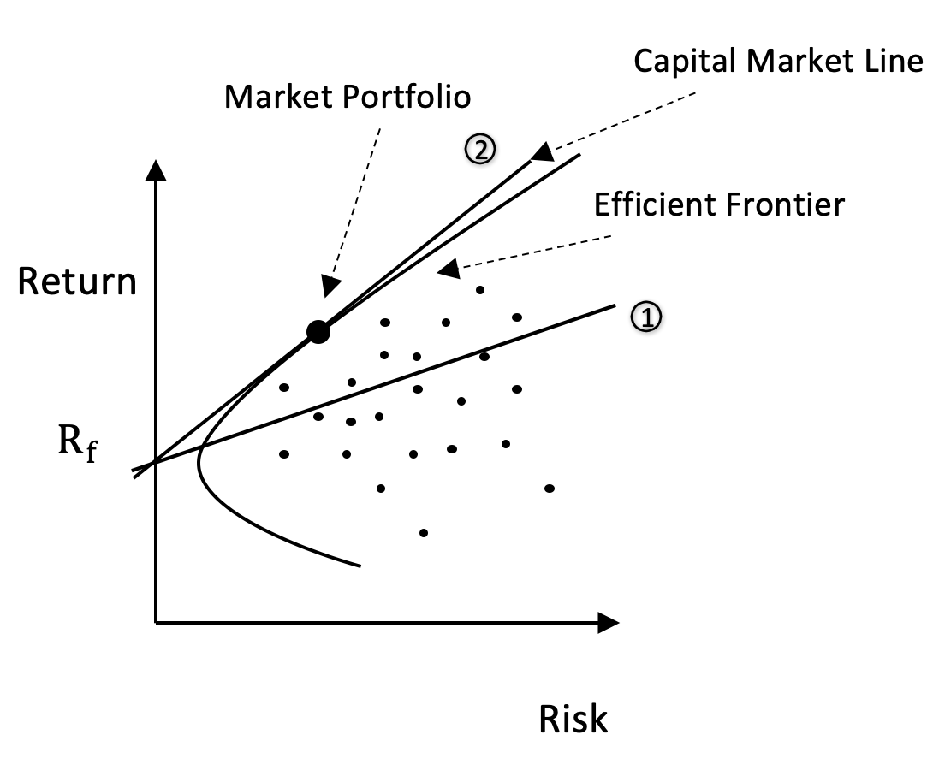
The Capital Market Line
Exhibit 1.5

Slide 11
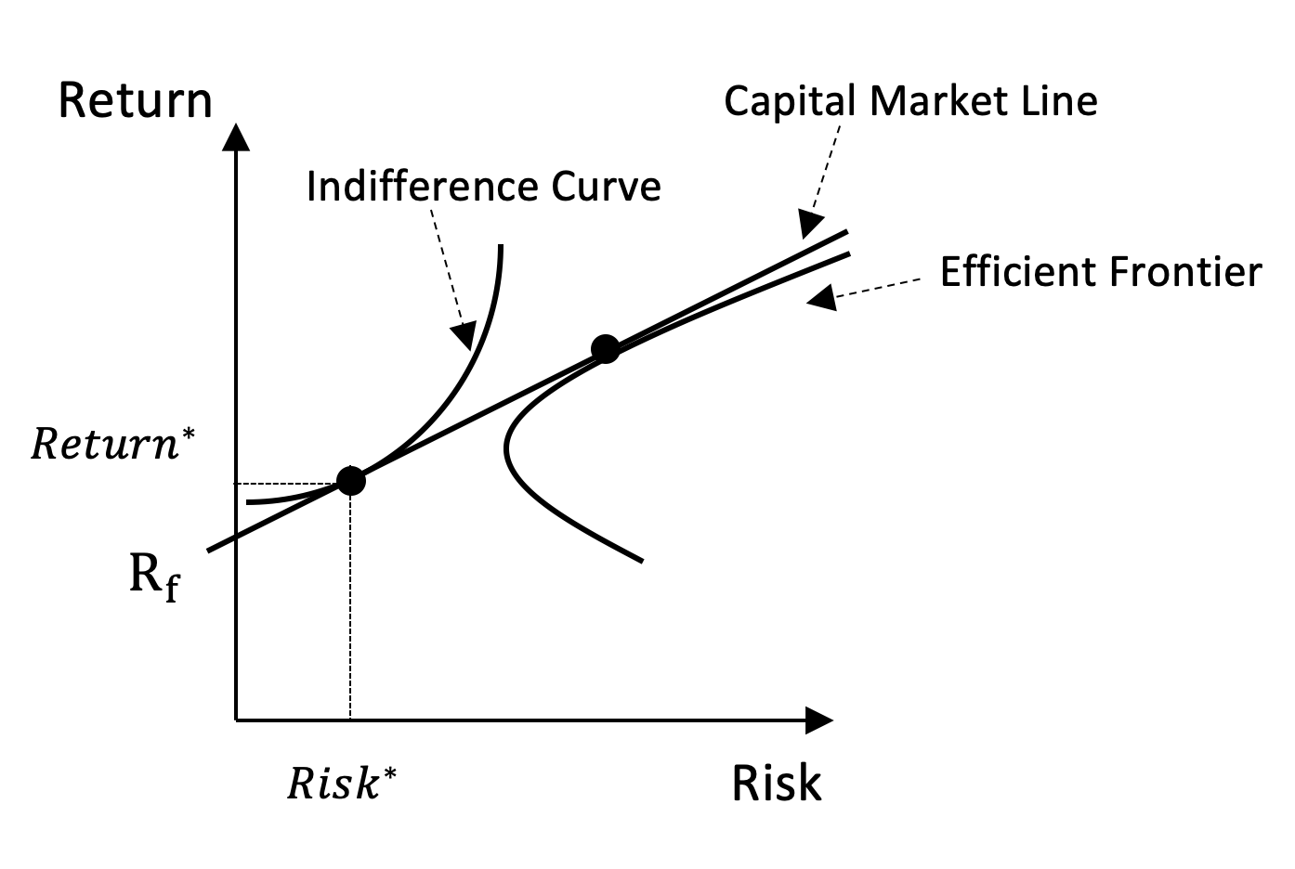
Investor Optimality
Exhibit 1.6

Slide 12
The Demand Curve to Hold Equity Shares

Slide 13
Derivation
References
“Security Market Microstructure” Analysis of a Non-Frictionless Market,” Francioni, Hazarika, Reck & Schwartz, The Handbook of Quantitative Finances, C.F. Lee and Alice Lee, Editors, Springer Science+Business, 2010
“ The Trading Decision and Market Clearing Under Transaction Price Uncertainty,” Ho, Schwartz, and Whitcomb, Journal of Finance, 1985
Reshaping the Equity Mrkets: A Guide for the 1990s, Schwartz, Harper Business, 1991

Slide 14
Assumptions
Share price and holdings are continuous variables
Short selling is unrestricted
A brief trading period followed by a single investment period
Max the expected utility of wealth as of the end of the investment period
Investor expectations wrt share price at the end of the investment period are exogeneous (independent of the current price of shares)
Investors are risk averse

Slide 15

The Starting Point
$$(21.1) EU\left(C_{1}R_{1}+N_{1}P_{2}\right)$$
(21.2) $h\left(P_{1}, Q | N_{0}, C_{0}\right)=EU[\left(C_{0}R_{0}−QP_{1}\right)R_{1}+\left(N_{0}+Q\right)P_{2}]$
C = cash
R =1 + rate of interest
N = number of shares held
P = price of shares
Q = number of shares bought/sold
0 = start of trading period
1 = end of trading period, start of investment period
2= end of investment period

Slide 16
Equation (21.2) Can Be Written As
(Taylor Expansion)
21.3 h(P₁,Q|N₀C₀) = c + gQ(a – bQ – P₁)
To simplify, let N₀= 0. Then,
c = U(W)
g = U’(W)R₁
a = E(P₂)/R₁
b = π/R₁
π = -1/2[U”(W)/U’(W)}Var(P)

Slide 17

Two Demand Curves:
Reservation and Ordinary
Reservation price (P^{R}) demand curve: max P to pay (or min to receive) if alternative is to not trade at all. So, in eq. 21.3, set $h\left(P_{1}, Q | N_{0}, C_{0}\right)$ = c Thus the reservation demand curve is
21.5 P^{R} = a - bQ
Ordinary price (P⁰) demand curve: Select the value of Q that maximizes expected utility by taking the derivative of eq. 21.3 wrt Q and setting it equal to zero. Thus the ordinary demand curve is
21.7 P^{O} = a – 2bQ

Slide 18
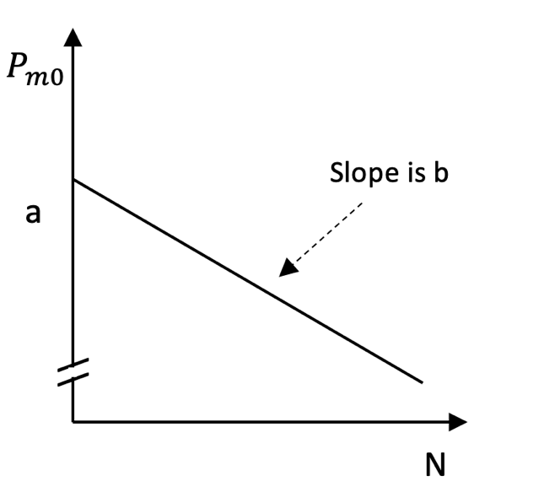
Ordinary Demand Curve to Hold Shares of the Market Portfolio: Exhibit 1.7
a
2b
As b goes to zero, the risky asset and the risk free asset become perfect substitutes and demand becomes infinitely elastic

Slide 19
The Linear Demand Curve
Does a linear demand curve make sense?
No, it would intersect the quantity axis, implying a finite demand to hold shares at a zero price
One further assumption wrt the Taylor expansion
The squared deviation of the expected rate of return on the risky asset from the risk-free rate is small enough to ignore

Slide 20
Demand Curve for Individual Stocks
CAPM
Non-systematic risk is eliminated by diversification
Systematic risk is a stock’s covariance with the market
Cov for one stock is replicated by combinations of other stocks
Thus all stocks have perfect substitutes
Thus the demand for each stock is infinitely elastic
Non-CAPM
Stocks do not have perfect substitutes
We take the demand curve for individual stocks to be downward sloping
Price discovery in a non-frictionless environment is noisy

Slide 21
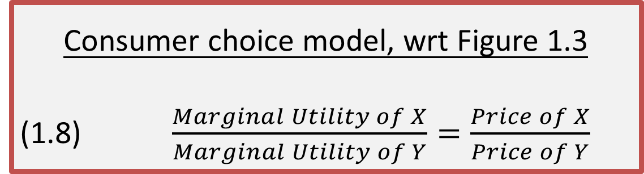
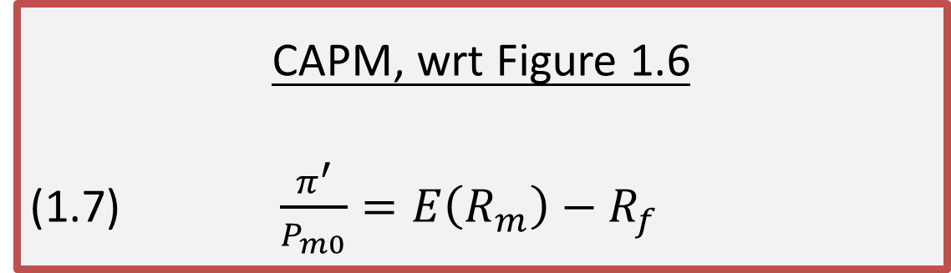
Optimality
Consumer choice model, wrt Figure 1.3
(1.8) $\frac{Marginal Utility of X}{Marginal Utility of Y}=\frac{Price of X}{Price of Y}$
CAPM, wrt Figure 1.6
(1.7) $\frac{π^{′}}{P_{m0}}=E\left(R_{m}\right)−R_{f}$
π’ = marginal risk premium

Slide 22

W, Percentage of Wealth in the Market Portfolio
(21.14) $w=\frac{E\left(r_{m}\right)−r_{f}}{Var\left(r_{m}\right)R_{R}}$
w is the weight in the market portfolio
R_{R} is the measure of relative risk aversion

Slide 23
A Supply Curve & Price Equilibrium
Could price equilibrium be where an aggegate market demand curve intersects a vertical line located by the number of shares outstanding?
Would this vertical line be the supply curve?
No it would not! As the number of shares changes and the curve shifts, it would trace out a rectangular hyperbola, and that would not be a demnd curve.
There is no supply curve!
So, how do we find an equilibrium price?

Slide 24
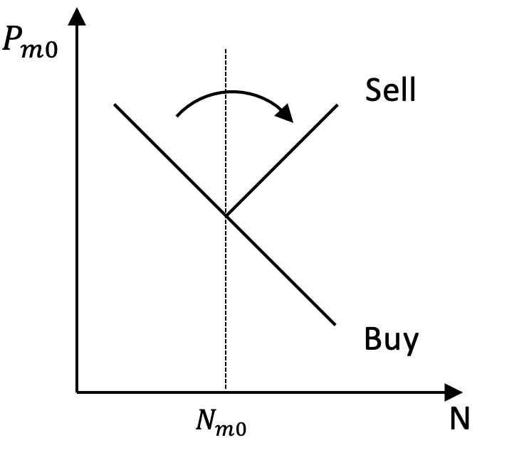
Transitioning from the Demand Curve to Buy and Sell Curves (Exhibit 1.8)

Slide 25
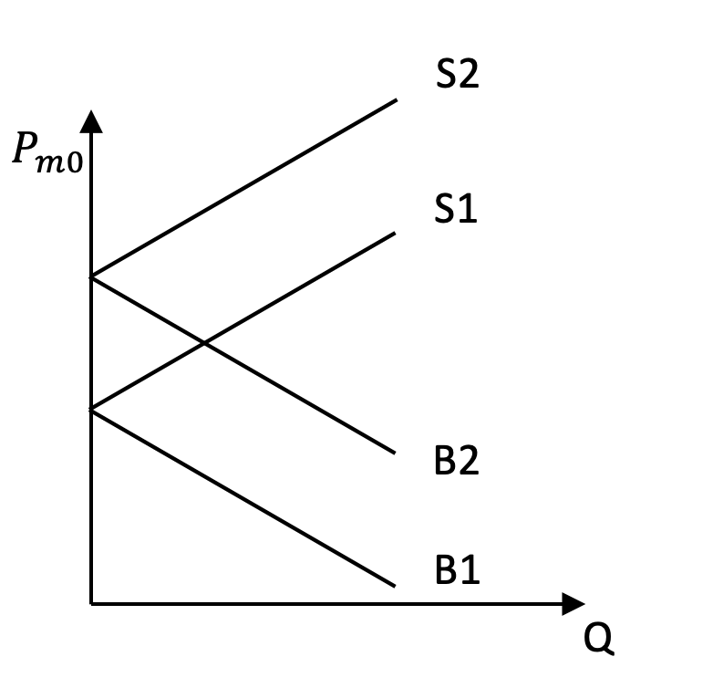
Buy and Sell Curves of Two Participants (Exhibit 1.9)

Slide 26
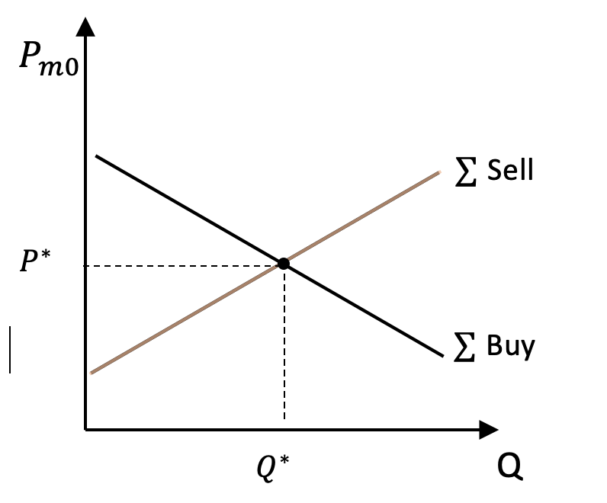
Market Buy and Sell Curves
(Exhibit 1.10)
P*is the equilibrium price
Q*is the equilibrium number of shares that trade

Slide 27
The Non-frictionless Market:
A Simple Representation
Assume investors know their complete buy & sell curves
Constrain participants to submitting just one order with a price and number of shares identified
Each participant’s strategic order placement is based on (1) the slope & intercept of his/her buy & sell curves and (2) expectation concerning P*
Assume the order placement decision is made before the market’s 9:30 open

Slide 28
Question: Will the Market’s Opening Price be P*?
Answer: Only by dumb luck! It would occur as a very special case that depends on the accuracy of investor expectations of P*, and on how their buy/sell curves are distributed around P*.
Conclusion: Our frictionless model (CAPM) gives a wonderfully efficient security market solution that one would expect from a microeconomic analysis of a perfectly competitive, perfectly liquid market. But the finding does not hold in a real-world financial market once friction is introduced.

Slide 29
Wrap-Up
We solved for frictionless market equilibrium values
Have shown that one simple friction can result in realized prices differing from equilibrium values
A far broader array of frictions are introduced in the Finance Chapter (Chpt 2)
Still, it is important to understand the determinants of a frictionless market equilibrium value
Remember our discussion of the Gulf Stream & the wind, waves, and storms on the surface of the sea

